Slide 1
Blog Post #2
My first ever screencast!

Slide 2
WAVE
I put my introductory post into WAVE, a web accessory evaluation tool meant for seeing how accessible my page is.
This program is helpful and can help me target problem areas for how accessible my page is to those who may need more flexible learning.
For example, people with visual disabilities may require a text to speech option as I practiced this week, or what I am doing now with my screencast.

Slide 3
Web Accessibility
Web accessibility is universal and while is necessary for those who struggle with learning disabilities, it has become often for class lectures to be on zoom such as when we were in COVID lockdown.
Because of this it's important to try and include as much accommodation as possible.
For example adding subtitles for those who have hearing difficulties as well as for those who may want to watch their lecture in a loud place or forgot their earbuds.

Slide 4
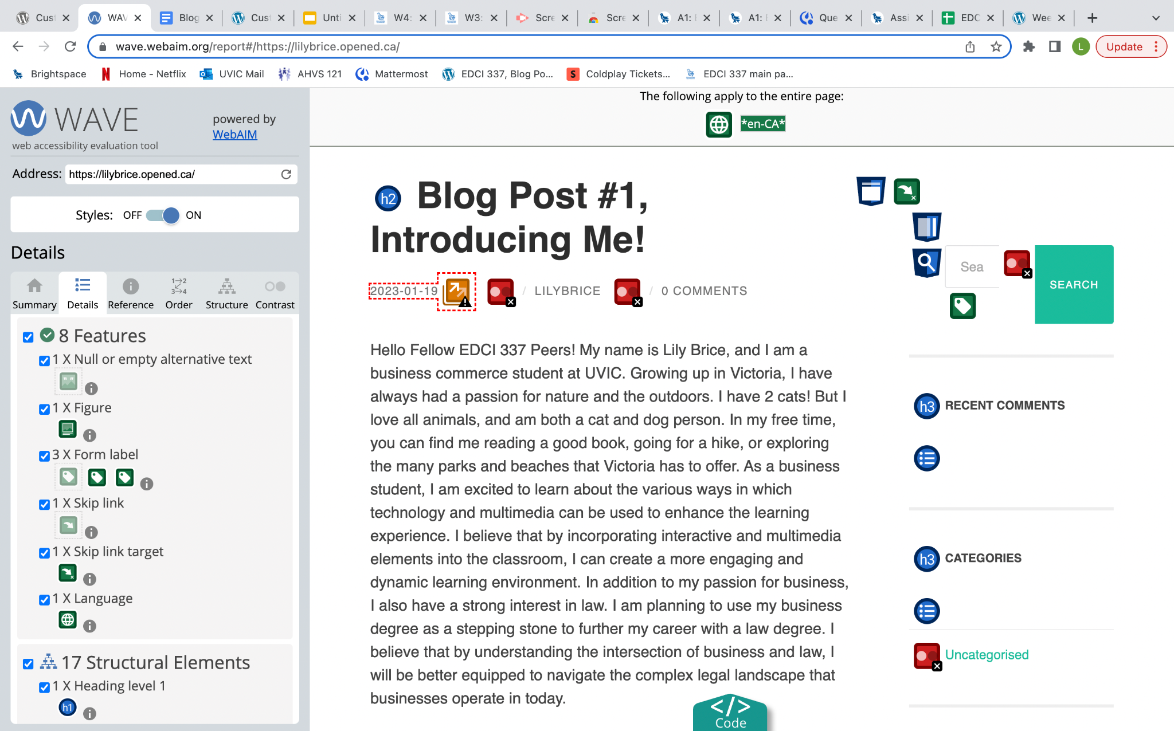
Upon my first summary from WAVE my page I did definitely have a few problems that need to be adjusted. I had very low contrast and a redundant link.

Slide 5
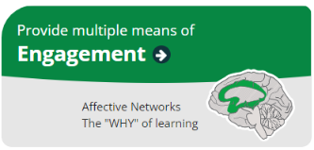
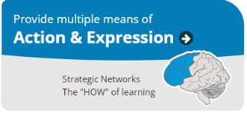
Over this semester with each blog post I am determined to use the points for universal design for learning (engagement, representation, and action and expression).

Slide 6
I will practice doing this by:
Focusing on one main point
Using bullet points,
Eliminating filler words
Getting feedback from my learning pod.
With a focus on building engagement, I am hoping to give the viewer more control!
A big part of engagement is removing extraneous load.

Slide 7
I don’t have much experience in video editing other than working with IMovie in high school, but I would like to continue working on this by using:
Different speed options
Different audio options
Captions
Create the most accessible video access.
To help me capture the right representation, I want to focus on my video editing!
This also connects to managing intrinsic load. I can make this possible by using a scaffolding technique that focuses on giving instruction and providing support during the learning process.

Slide 8
When I was trying to resolve and issue with my text I had trouble changing the colours.
I was focused on making my super low contrast page less of a problem.
Unfortunately the theme option I had chosen makes it impossible to change the light grey text overtop of the white background.
This is something I have been trying to play around with a little. Will different themes have a different outcome on WAVE? Over the semester this is definitely something I will look into.
To work on action and expression I want to focus on the things the WAVE really picked out in my site.
This refers to my:
Text
Audio
Images
Videos
and how to make all of these more accessible.

Slide 9
Thank You!
In conclusion, having an accommodating blog is not only a moral responsibility but also a practical one. It helps you reach a larger audience and enhance the user experience.
By making your blog accessible, you contribute to a more inclusive and diverse online community.

